Slide 1
Faculty of Information Technology and Communication Sciences (ITC)

Slide 2
The ITC faculty covers the full spectrum of transmitting and processing matter, information and meaning.

Slide 3
ITC Faculty 2020
743
Personnel
68 M€
Total funding
1028
Peer reviewed publications
4950
Bachelor/Master's students
450
Doctoral students
Computing Sciences
Communication Sciences
Electrical Engineering
Languages

Slide 4
Organizational structure
Degree Programmes
Dean Jyrki Vuorinen
ITC Management Group:
Dean
Vice Deans
Heads of Units
Heads of degree programmes*
Heads of doctoral programmes*
Heads of Study Services
Senior Specialist (Finance)
Research Specialist
HR Partner
Faculty Manager
Communications Officer
Faculty Coordinators
Vice Dean for Education Kati Iltanen
Faculty Council
Management
Vice Dean for Research Juho Hamari
Faculty Services
* Extended management group
Electrical Engineering
Head: Mikko Valkama
Staff: 149
Students:
Professors: 13
Assistant Professor (tenure track): 4
Computing Sciences
Head: Timo Hämäläinen
Staff: 410
Students:
Professors: 27
Associate Professor (tenure track): 8
Assistant Professor (tenure track): 5
Associate Professors: 1
Professor of Practice: 1
Full time Teachers: 45
Communication Sciences
Head: Iiris Ruoho
Staff: 121
Students:
Professors: 11
Associate Professor (tenure track): 4
Associate Professors: 2
Professor of Practice: 1
Languages
Head: Kaisa Koskinen
Staff: 60
Students:
Professors: 10
Associate Professor (tenure track): 1
Associate Professors: 1
UNITS

Slide 5
ITC Personnel (n=743)
* 1st = Doctoral Researchers, Project Researchers 2nd = Assistant Professors, Postdoctoral Research Fellows, University Instructors 3rd = Associate Professors, University Lecturers, Senior Research Fellows, Project Managers 4th = Professors and Research Directors
Male 68%, n=508
Female 32%, n=235

Slide 6
ITC Funding 2020

Slide 7
Publications 2019–2020 Peer reviewed publications (classes A1–A4 and C1–C2)
9 %
11 %
10 %
11 %
19 %
22 %
22 %
22 %
66 %
61 %
61 %
60 %
6 %
6 %
7 %
7 %
Source: TUNICRIS 4/2021
Notes:
Final Results from 2020 (updated 7/2021).
The figure includes only the publication types A1-A4 and C1-C2 of the Ministry of Education and Culture = peer-reviewed scientific or scholarly articles in journals, conferences and compilations, as well as to scholarly books.

Slide 8
Publications 2020
Source: TUNICRIS 4/2021
Notes:
Final results from 2020 (updated 7/2021).
The figure includes only the publication types A1-A4 and C1-C2 of the Ministry of Education and Culture = peer-reviewed scientific or scholarly articles in journals, conferences and compilations, as well as to scholarly books.

Slide 9
Some of our research highlights
EU | ERC | H2020 MSCA-IF |  | H2020 projects
 | SCARE: Side-Channel Aware Engineering (Billy Brumley, StG 2018–2023) MULTIMAG: Multiscale Magnetic Models for Emerging Energy Conversion Applications (Paavo Rasilo, StG 2020–2025) | GANDALF (2019–2021, superv. Hamari) WEARTUAL (2019–2021, superv. Hamari) ENTRAP (2019–2022, superv. Rasilo) FALCON (2021–2023, superv. Gabbouj) AUGMENTED-HUMANS (2021–2023, superv. Hamari) GAMINCLUSIVE (2021–2023, superv. Hamari) CryptoVolatility (2021–2023, superv. Kanniainen) UNOPIEZO (Global Fellowship, TAU 2023, superv. Mäntysalo) |  | ITC as the coordinator: DIOR: Deep Intelligent Optical and Radio Communication Networks (2021–2025, 1.9M€, Tan) Some of ITC partnership projects: ADACORSA: Airborne data collection on resilient system architectures (2020–2023, 42M€, Mäntysalo) OpenDR: Open Deep Learning Toolkit for Robotics (2020–2022, 6,7M€, Gabbouj) MARVEL: Multimodal Extreme Scale Data Analytics for Smart Cities Environments (2021–2023, 6M€, Virtanen) ASCLEPIOS: Advanced Secure Cloud Encrypted Platform for Internationally Orchestrated Solutions in Healthcare (2018–2021, 4,8M€, Michalas) CORE: Children Online: Research and Evidence. A knowledge base on children and youth in the digital world (2020–2022, 1,7M€, Kotilainen)
Academy of Finland | Flagship programme, Centres of Excellence |  | Strategic research council (SRC) |  | University profiling
 | Flagship: Forest-Human-Machine Interplay (UNITE, 2020-2023, contact Juho Hamari) CoE: Game Culture Studies (2018-2025, coordinator Frans Mäyrä) CoE: Inversion modelling and Imaging (2018-2025, contact Mikko Kaasalainen) |  | ITC as the coordinator: ETAIROS (2019–2025, consort. leader Nummenmaa) ITC as a partner: ALL-YOUTH (2018–2023, consort. leader in SOC; Väänänen in ITC) EL-TRAN (2015–2023, consort. leader in MAB; Järventausta in ITC) IDA (2019–2025, consort. leader in UTU; Nikunen in ITC) Growing Mind (2018–2023, consort. leader in UH; Mäyrä in ITC) BIBU (2017–2021, concort. leader in UH; Nikunen in ITC) ROSE (2015–2021, consort. leader in Aalto; Kämäräinen in ITC) |  | PROFI 6: Games as a Platform to Tackle Grand Challenges PROFI6: TAU Imaging Research Platform
More information of the projects (www)

Slide 10
Research Infrastructures
Our advanced research infrastructure comprises the range of facilities, resources and services that are necessary for conducting high-quality research.
National research infrastructures (FIRI funding by Academy of Finland)
Future Wireless Communication Networks (FUWIRI, Mikko Valkama) Future Wireless Communication Networks (FUWIRI-6G, Mikko Valkama) Printed Intelligence Infrastructure (PII, Matti Mäntysalo) National Infrastructure for human virtualization and remote presence (MAGICS, Atanas Gotchev)

Slide 11
Research Infrastructures
by responsible Staff/Senior Scientist
Technology-media-communication-interaction
Imaging
Imaging PROFI6
Wireless
Electronics and embedded systems
Electrical energy engineering
Computer networking lab
Security
Languages infras
Cryolab
Soc Hub
TAUCHI
IoT test network
Electromechanics
Robo Studio
CIVIT
Smart Grid lab
FPGA Lab
LUDUS
RF labs
LFE
Game Lab
Theatre Studio
5G test network
Power Electro nics
Comput. IMG and digital hol. Lab
Agco generator motor (ITC+ENS)
Embedded
systems
OASIS
EMC lab
Antenna measurem.lab
Electronics and
energy
News Lab
High Voltage lab
PAIDIA
Audio lab
Poika Isokoski
Jussi Rantala
Nataliya Strokina
Joonas Säe
Jari Keskinen
Kari Lahti

Slide 12
Electrical Engineering
Electrical and electromagnetic natural phenomena are utilized in a variety of ways, covering e.g. the generation, transmission, distribution and usage of electrical energy as well as sensing, processing and communicating information. To address the increasing needs for digitalization and sustainability, our research focuses on solving modern engineering problems, such as solar and wind power generation, electric vehicles, smart medical and health care systems and connecting all people and things through wireless communications.
Electronics and Embedded Systems
Electrical Energy Engineering
Communications Engineering and Radio Systems
Head: Prof. Mikko Valkama
Number of Staff: 149
www: Electrical Engineering

Slide 13
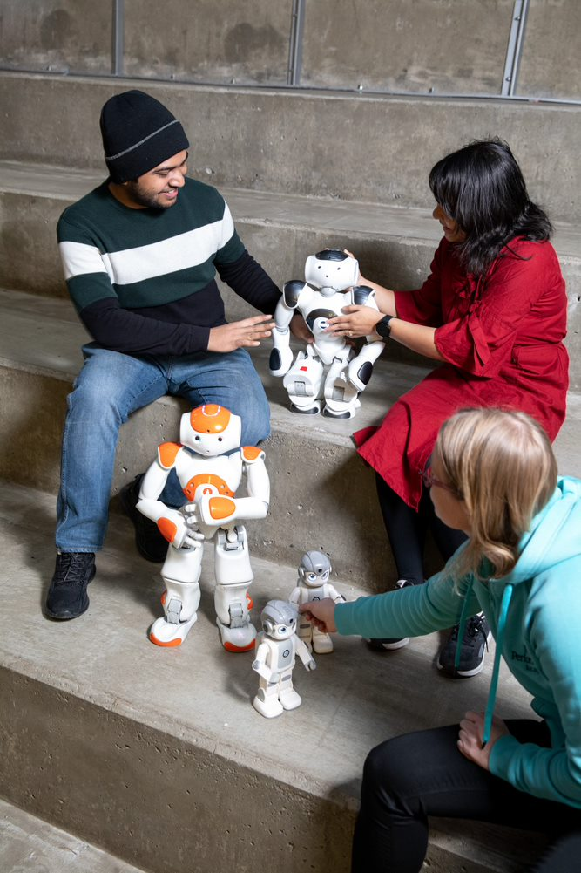
Computing Sciences
Computing Sciences cover all essential areas of Information Technology and Mathematics - From Human-Computer Interaction to Mathematics, from Software to Hardware, from Data to Logic, from sight to scent, from human to robot – with world renown results to scientific and industrial challenges.
Human media interaction
Human technology interaction
SW process
SW design
Logic and algebra
Data and knowledge modeling
Inverse problems and mathematical analysis
Machine learning
Statistical data analytics
Audio signal processing
Computer engineering
Network and information security
Computer and robot vision
Image and video signal processing
Head: Prof. Timo Hämäläinen
Number of Staff: 440
www: Computing Sciences

Slide 14
Communication Sciences
The Communication Sciences Unit conducts research that delves into our increasingly hybrid media landscape and the role of communication technologies in reshaping not only our thoughts and sensibilities but also our relations with others. The knowledge produced by the multidisciplinary research centres is methodologically innovative and provides analytical and interpretive tools for understanding globalization, multiculturalism, mediation and digitalization.
Tampere Research Centre for Journalism, Media and Communication (COMET)
Tampere Research Center for Information and Media (TRIM)
The Centre for Practise as Research in Theatre (T7)
Head: Prof. Iiris Ruoho
Number of Staff: 121
www: Communication Sciences

Slide 15
Languages
Research in Languages covers linguistic, literary and translation studies. It is coordinated by our research centre Plural. Language and culture have a pivotal role in the questions concerning social sustainability. Our research into issues such as multimodality, accessible communication and the relationship of language practices and the changing landscapes of work contributes to participation, equality and well-being of language users.
Multidisciplinary Research Centre for Languages and Cultures Plural
Head: Prof. Kaisa Koskinen
Number of Staff: 60
www: Languages

Slide 16
Education
Education at the Faculty of Information Technology and Communication Sciences draws on our unique combination of recognised expertise across a range of disciplines, including the humanities, natural sciences, engineering, social sciences, and theatre and drama. The broad spectrum of disciplines present within our Faculty opens up excellent opportunities to deliver multidisciplinary education across organisational boundaries. Our Faculty has the potential to generate knowledge and future game-changers to the complex challenges of our global, digital and multicultural society.
985
degrees
4950
Bachelor/Master's students
450
Doctoral students
435
BACHELOR’S
DEGREES
523
MASTER’S
DEGREES
27
DOCTORAL DEGREES
| 16

Slide 17
Bachelor Programmes
Kielten kandidaattiohjelma
Matematiikan ja tilastollisen data-analyysin kandidaattiohjelma
Teatterityön kandidaattiohjelma
Tieto- ja sähkötekniikan kandidaattiohjelma
Tietojenkäsittelytieteiden kandidaattiohjelma
Viestinnän monitieteinen kandidaattiohjelma

Slide 18
International Master's Programmes
Master's Programmes
Kielten maisteriohjelma
Monikielisen viestinnän ja käännöstieteen maisteriohjelma
Informaatiotutkimuksen maisteriohjelma
Journalistiikan maisteriohjelma
Media, kulttuuri ja yhteiskunta -maisteriohjelma
Viestinnän maisteriohjelma
Visuaalisen journalismin maisteriohjelma
Teatterityön maisteriohjelma
Matematiikan maisteriohjelma
Tietojenkäsittelyopin maisteriohjelma
Sähkötekniikan DI-ohjelma
Tietotekniikan DI-ohjelma
Master's Programme in Game Studies
Master's Programme in Sustainable Digital Life
Master's Programme in Computing Sciences
Master's Programme in Electrical Engineering
Master's Programme in Information Technology

Slide 19
Doctoral Programmes
Doctoral Programme in Interactive Technology
Doctoral Programme of Computing and Electrical Engineering
Doctoral Programme in Dynamic Wearable Applications with Privacy Constraints
Doctoral Programme in Plenoptic Imaging
Doctoral Programme in Communication, Media and Theatre
Doctoral Programme in Language Studies

Slide 20
H2020 MSCA ITN
The Innovative Training Networks
ITC coordinating
ImmerSAFE (2018–2021, Gotchev)
A-WEAR (2019–2022, Lohan)
APROPOS (2020–2022, Nurmi)
PLENOPTIMA (2021–2024, Gotchev)
ITC participating as a partner
CHARISMA (2019–2023, Lupo)
AERO-TRAIN (2021–2024, Gotchev)
PROTrEIN (2021–2024, Hamari)

Slide 21
Faculty contact information:
Email itc.tau@tuni.fi
Dean jyrki.vuorinen@tuni.fi
Vice Dean for Education kati.iltanen@tuni.fi
Vice Dean for Research juho.hamari@tuni.fi
Twitter @ITC_TampereUni
www ITC Faculty Website
Heads of Units:
mikko.valkama@tuni.fi Website: Electrical Engineering
timo.hamalainen@tuni.fi Website: Computing Sciences
iiris.ruoho@tuni.fi Website: Communication Sciences
kaisa.koskinen@tuni.fi Website: Languages
Kuvat: Jonne Renvall, Tampere University

